Slide 1
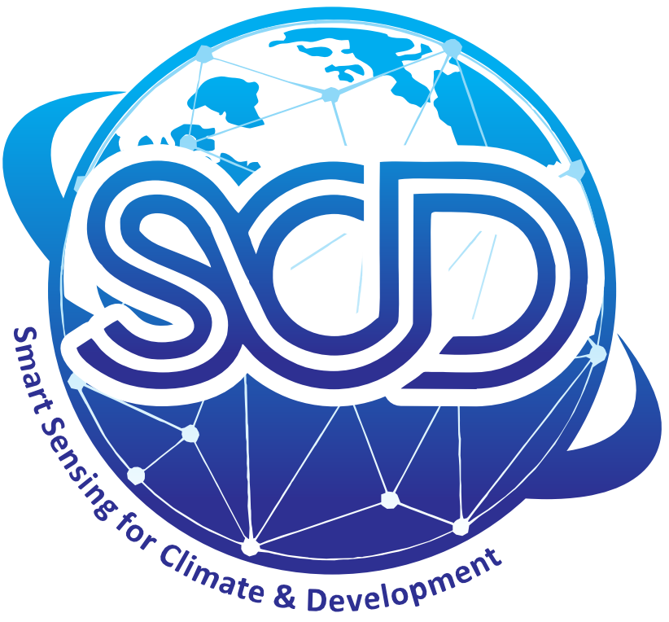










New Developments in the Centre for Geographical Information System
Sawaid Abbas, PhD
,
sawaid.abbas@connect.polyu.hk
sawaid.gis@pu.edu.pk
GIS Day, 17 Nov 2023
Notes:
Good Morning everyone, thank you for giving me an opportunity to talk about Big Data and Cloud Computing for mapping crop intensification in Pakistan. The idea is based on evaluating the potential of open access solution to replace existing about replacing existing enterprises solution.

Slide 2
PhD Program
Aiming to launch PhD program in September 2023
PhD in Geospatial Science (Remote Sensing and GIS)
15 PhD Candidates
Designing Course
Consultative Meeting

Slide 3
Smart Sensing for Climate and Development
“establish a group of researchers to strengthen quality of research by integrating cutting-edge geospatial technologies and data for smart and sustainable development”

Slide 4
Smart Sensing for Climate and Development
Platform for Students
Transform Learning into Actions
Apply Existing Skills for Research and Development
Explore New Horizons for Contemporary Skills
Bridge Gap between Academia and Industry

Slide 5
Smart Sensing for Climate and Development
Smart Sensing
& Earth Observation
Environmental Monitoring
Ecosystem
Smart
Cities
Spatial Analytics
&
Geo-AI
Natural
Resources
Climate
Change
Big Data
&
Cloud Computing
Sustainable
Development

Slide 6
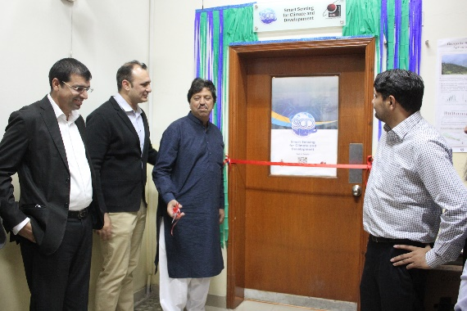
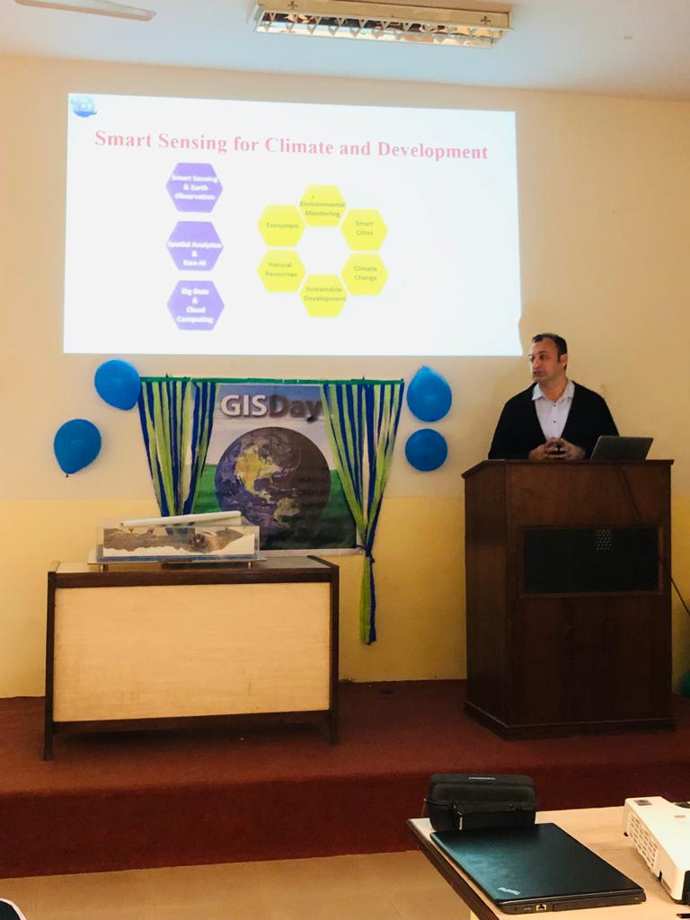
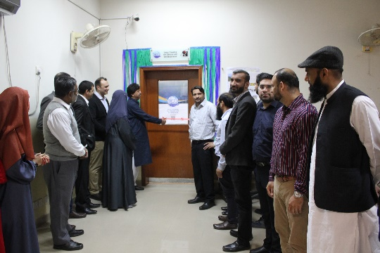
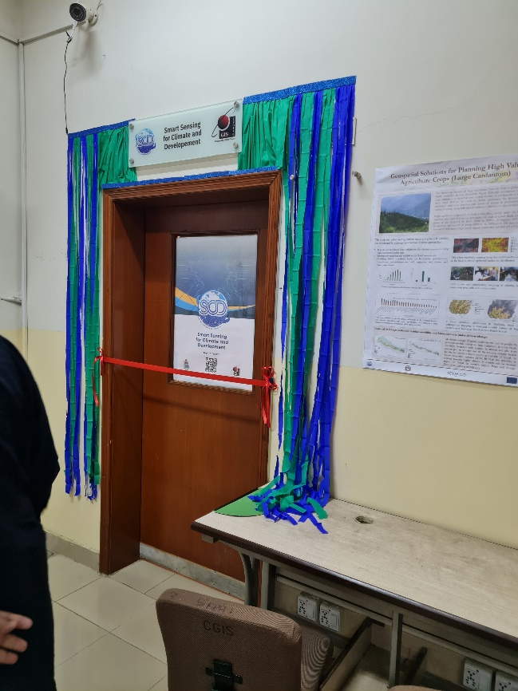
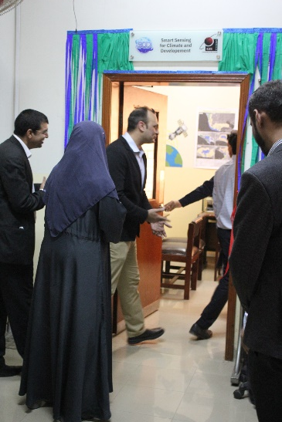
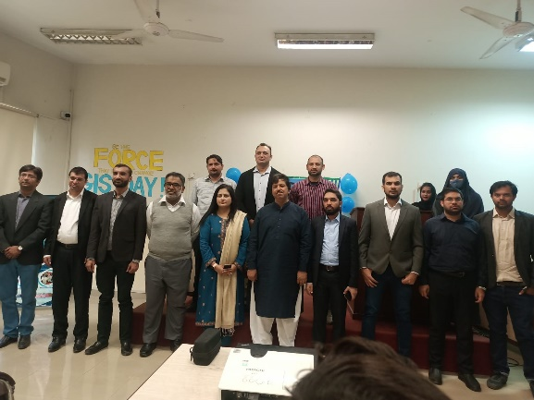
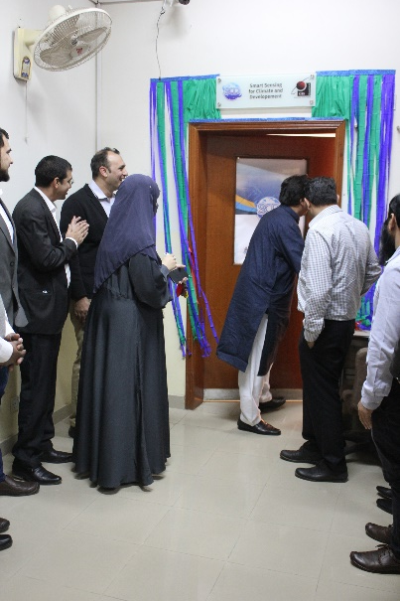
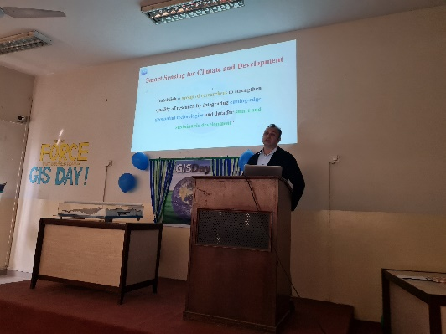
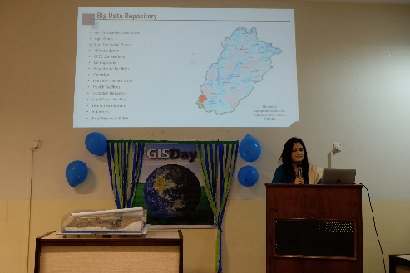
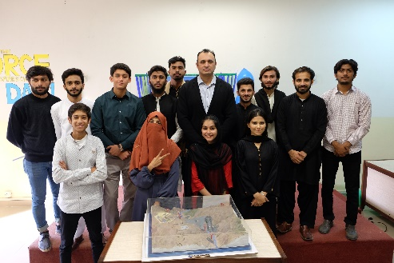
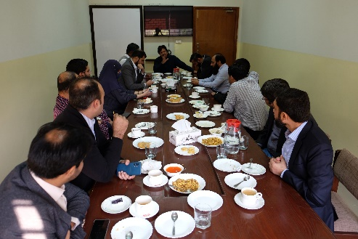
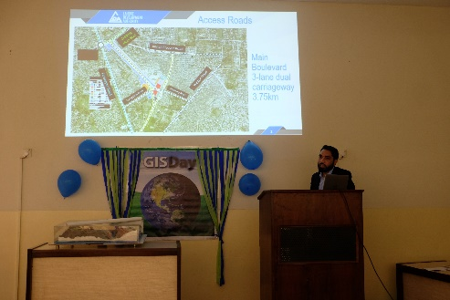
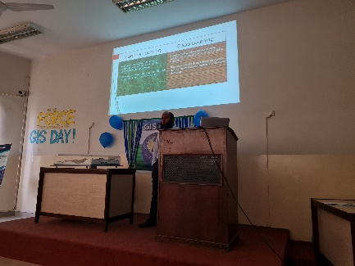
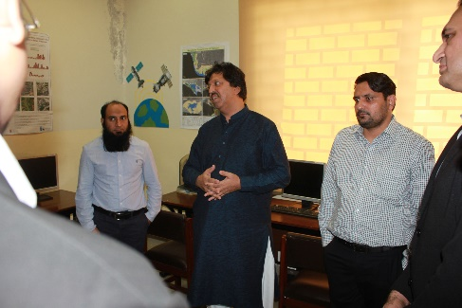
Inauguration of the SCD on 17 Nov 2022

Slide 7
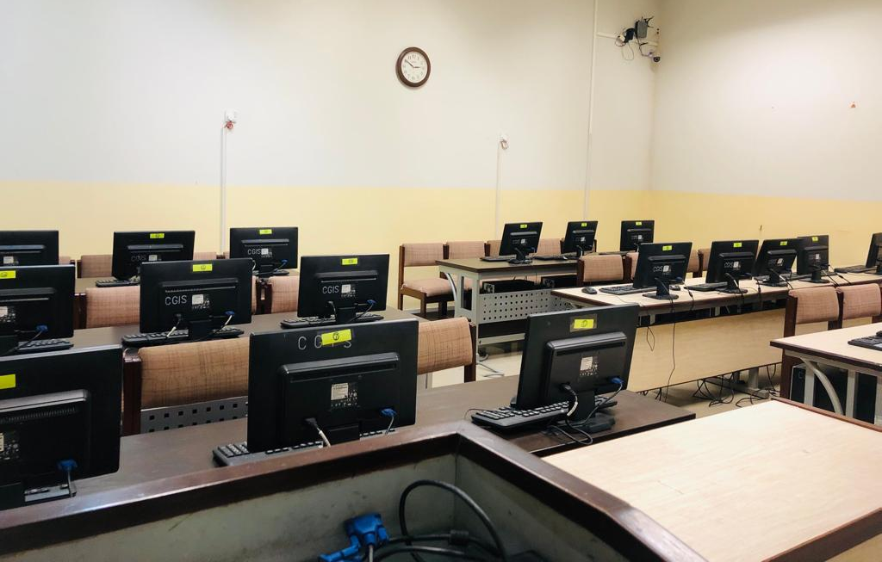
MPhil Lab

Slide 8
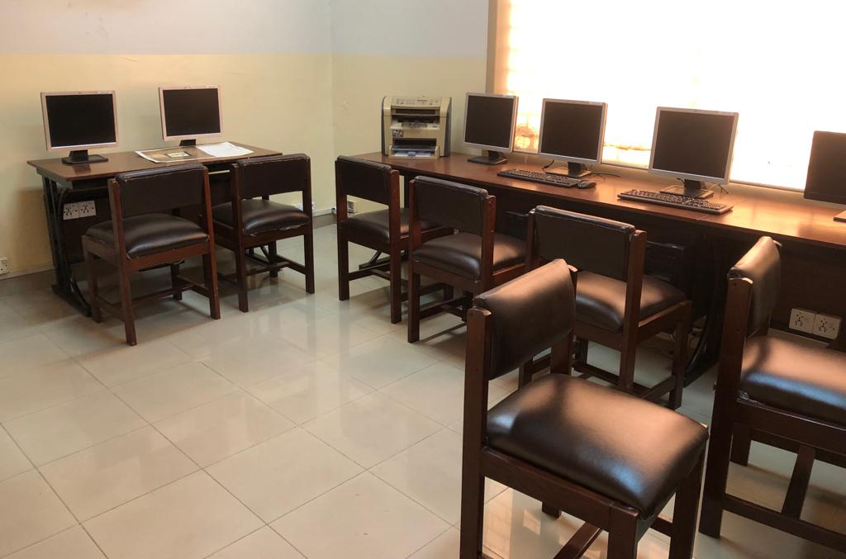
New Research Lab

Slide 10

Thank you for your attention!

